Slide 1

Team Maha Yehia Ekram Fahmy Ahmed Mohamed Fathy Zeinab Mahmoud Anwer HebatAllah Ahmed Mohamed Mohammed Ahmed Mostafa
Software Testing

Slide 2
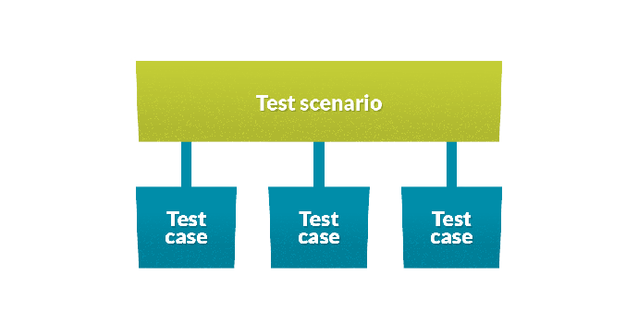

What is Testing
Software Testing is a method to check whether the actual software product matches expected requirements and to ensure that software product is defect free.
It ensures that the project is working fine in every scenario and gives the perfect output as expected , It helps to avoid unwanted things like bugs.

Slide 3
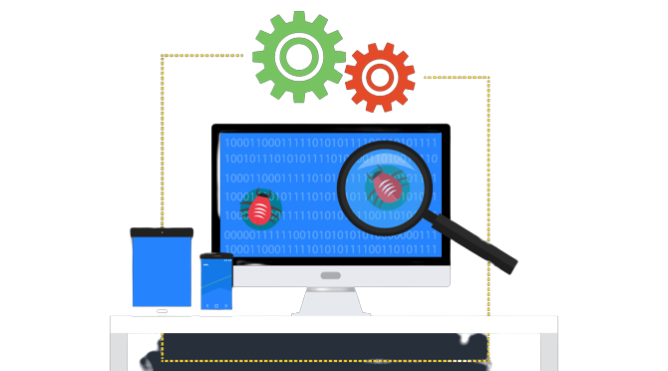
The History and Background
Software testing didn’t evolve in a single day
1. Debugging (early 1950s) fixing bugs
Developers used to write code, and when faced with an error would analyze and debug the issues. There was no concept of testing or testers.
2. Demonstration (1957~1978)
Testing was carried out as a separate activity. the major goal of software testing was to make sure that software requirements were satisfied.
3. Destruction (1979~1982)
The focus was on breaking the code and finding the errors in it.
(e.g. entering letters in a field that should only accept numbers)

Slide 4

The History and Background cont.…
4. Evaluation(1983~1987)
The focus was on evaluating and measuring the quality of software. Testers tested until they reached an acceptable point, where the number of bugs detected was reduced.
5. Prevention(1988~2000)
Saw a new approach, with tests focusing on demonstrating that software met its specification, detecting faults and preventing defects.

Slide 5
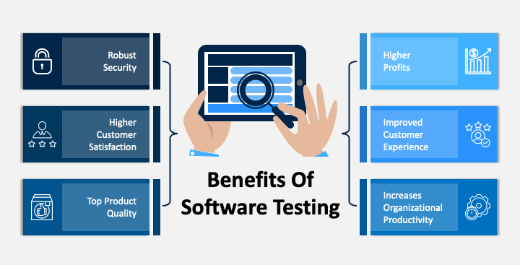
Software Testing objectives rg

Slide 6
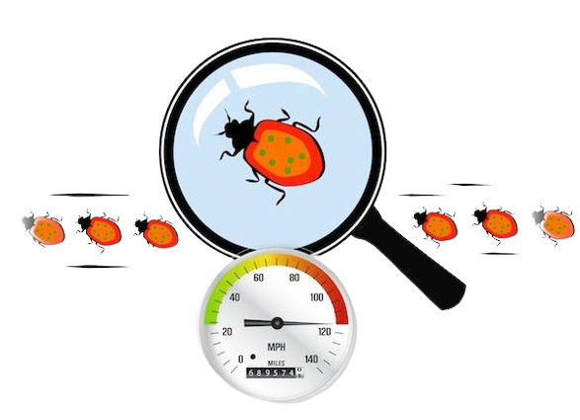
What is The Difference Between ?
Error
A human action that produces an incorrect result.
Section of the code that are incorrect as a result of grammatical, logical or other mistakes made by a system analyst, a programmer, or another member of the software development team.
Defect
It can be simply defined as a variance between expected and actual. Defect is an error found after the application goes into production.
Bug
It is described as an issue or error that can cause the software to behave in other ways that are not expected by the user or intended by the developer.
Failure
Once the software is ready tested and verified by testers and the end user facing some issues in the production.

Slide 7

7 Principles of Software Testing

Slide 8
1) Exhaustive testing is not possible
Yes! Exhaustive testing is not possible. Instead, we need the optimal amount of testing based on the risk assessment of the application.

Slide 9
2) Defect Clustering
Approximately 80% of the problems are found in 20% of the modules.
By experience, you can identify such risky modules.

Slide 10
3) Pesticide Paradox
Repetitive use of the same pesticide mix to eradicate insects during farming will over time lead to the insects developing resistance to the pesticide Thereby ineffective of pesticides on insects.
In software testing, If the same set of repetitive tests are conducted, the method will be useless for discovering new defects.

Slide 11
4) Testing shows a presence of defects
Testing talks about the presence of defects and doesn’t talk about the absence of defects.
Software Testing reduces the probability of undiscovered defects remaining in the software but even if no defects are found, it is not a proof of correctness.

Slide 12
5) Absence of Error – fallacy
Finding and fixing defects does not help if the system build is unusable and does not fulfill the user’s needs & requirements.

Slide 13
6) Early Testing
Testing should start as early as possible in the Software Development Life Cycle.
So that any defects in the requirements or design phase are captured in early stages.

Slide 14
7) Testing is context dependent
All the developed software’s are not identical. You might use a different approach, methodologies, techniques, and types of testing depending upon the application type.

Slide 15
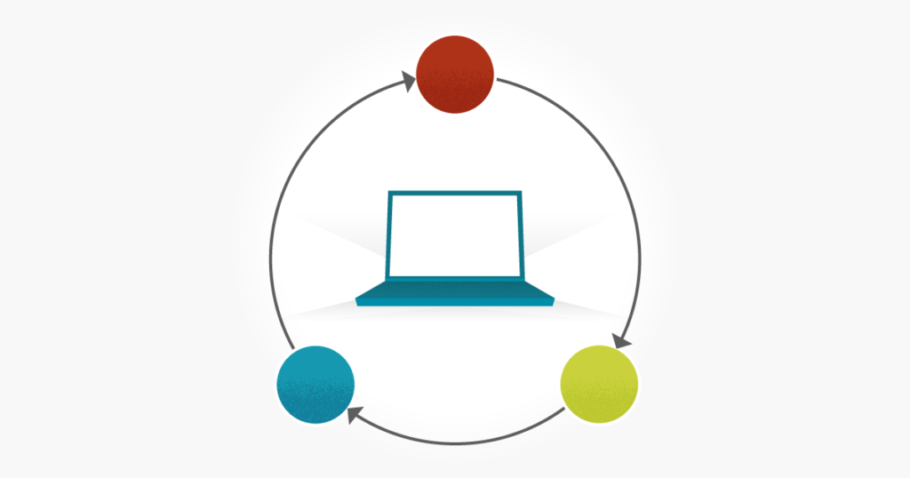
Test Driven Development (TDD)

Slide 16
Traditionally
Code
Compile
test

Slide 17
Test Driven Development (TDD)
Write a test
See it fail
Make it better
Make it pass

Slide 18
Test Driven Development (TDD)
A software development approach in which test cases are developed to specify and validate what the code will do.
In simple terms, test cases for each functionality are created and tested first and if the test fails then the new code is written in order to pass the test and making code simple and bug-free.
This process not only helps ensure correctness of the code -- but also helps to indirectly evolve the design and architecture of the project at hand.

Slide 19
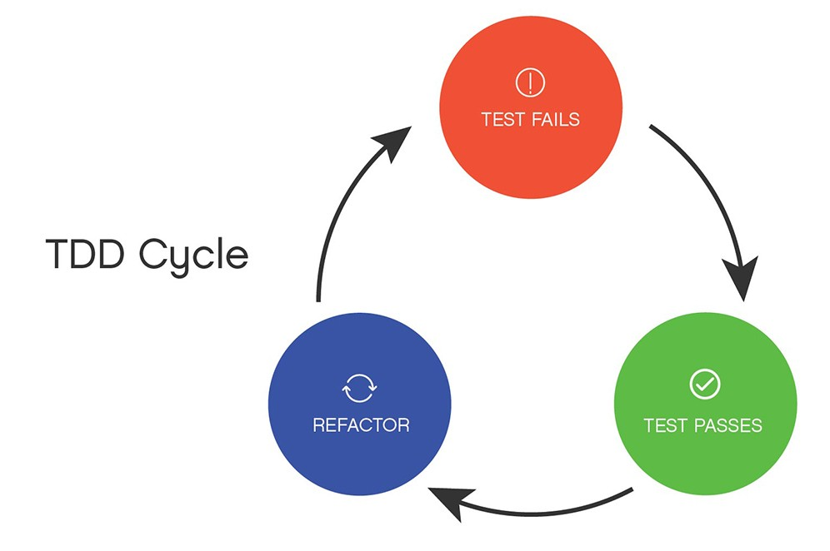

Slide 20
Test Driven Development Cont.
This process sounds slow, and it often can be in the short-term, but it does improve the quality of the software project in the long-run.
Having adequate test coverage acts as a safeguard so you don't accidentally change the functionality.
It's much better to catch a bug locally from your test suite than by a customer in production.
Notes:
Approaches
There are two main approaches to TDD -- Inside Out and Outside In.
Inside Out
With the Inside Out (or the Detroit School of TDD or Classicist) approach, the focus is on the results (or state). Testing begins at the smallest unit level and the architecture emerges organically. This approach is generally easier to learn for beginners, attempts to minimize mocking, and helps prevent over-engineering. Design happens at the refactor stage, which can unfortunately result in large refactorings.
Outside In:
The Outside In (or the London School of TDD or Mockist) approach focuses on user behavior. Testing begins at the outer-most level and the details emerge as you work your way in. This approach relies heavily on mocking and stubbing external dependencies. It's generally harder to learn, but it helps ensure that the code aligns to the overall business needs. Design happens at the red stage.

Slide 21
TDD Benefits
Simple Design
Reduce costs
Make refactoring and rewriting easier
Prevent bugs and coupling
Increase confidence that the code works as expected
Eliminate fear of change

Slide 22
TDD Concerns
Simple doesn’t mean easy
Slow Process
Tests help to seek out bugs, but they can not find bugs that you simply introduce within the test code and in implementation code.
Tests got to be maintained when requirements change

Slide 23

Test Levels

Slide 24
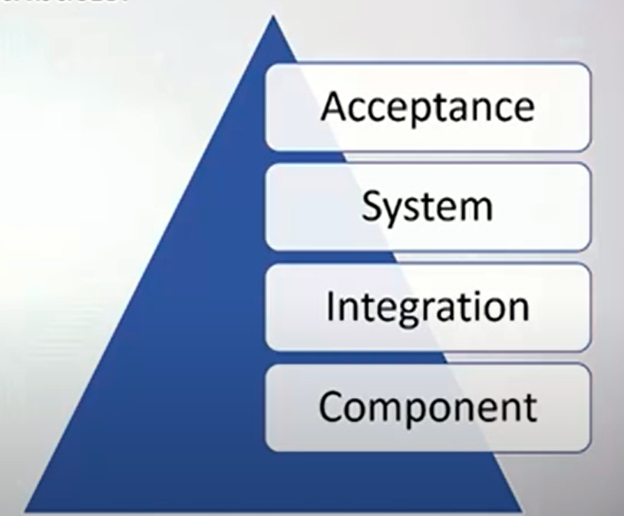
Test Levels
Test levels are groups of test activities that are organized and managed together.
Each test level is an instance of the test process.
Notes:
Test levels are related to other activities within the software development lifecycle

Slide 25
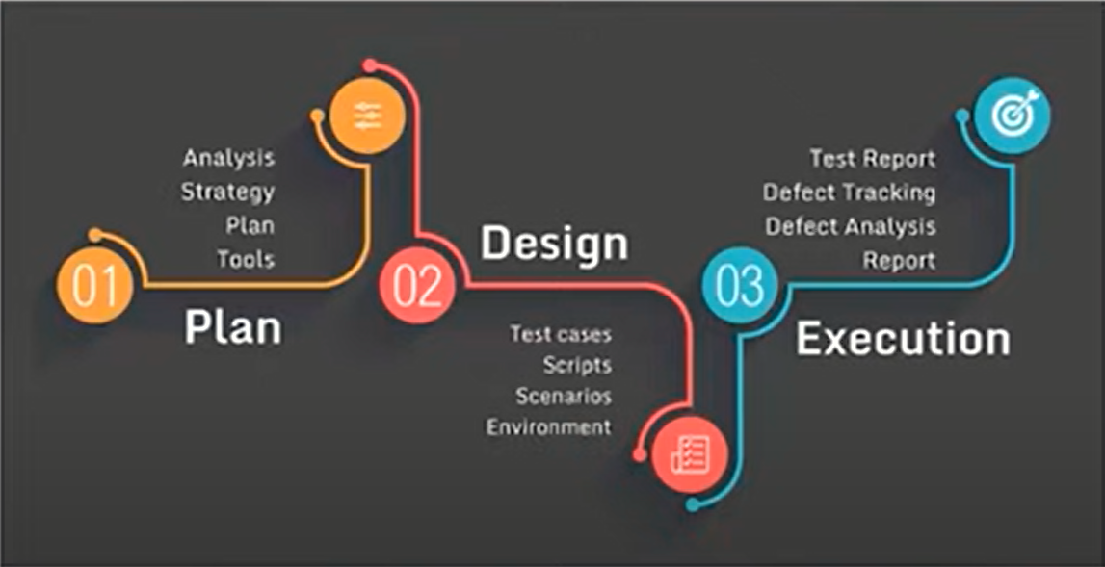
Test Process
There is no one universal software test process.
but there are common sets of test activities.
Notes:
الخطوات الي بمشي عليها وانا بعمل testing
Test Planning => Test Plans
Test Monitoring & Control => Test Progress - Summary Reports
Test Analysis => Test Conditions
Test Design =>Test Cases – Test Data
Test cases help to check if a particular module/software is meeting the specified requirement or not
A test case consists of a certain set of conditions that need to be checked to test an application or software
Test conditions are the constraints that you should follow to test an application.
Example: When User Name and Password are valid then application will move forward.
Test plan => test obj , risks , budget
Test monitoring and control => ongoing comparison [actual result , expected result (test plan) ]
Test analysis => what to test [analysis test basis [req , risks , code , design ] ] => and depends on it بطلع ال test conditions
Test Design => how to test [identify test environment => production , development ]
Test completion
Check defects report
milestones مش شرط انه يكن ف نهاييه ال بروجيكت لا ممكن يكون ف نهايه كل
Hand over testware عشان يقدروا يعملا maintenace

Slide 26
Unit Testing
Unit testing whether individual units of software, the piece of code or individual program is executed as defined.
Types of Unit Testing:
Manual
Automated.
Unit Testing Techniques:
Black-box Testing
White-box Testing.

Slide 27
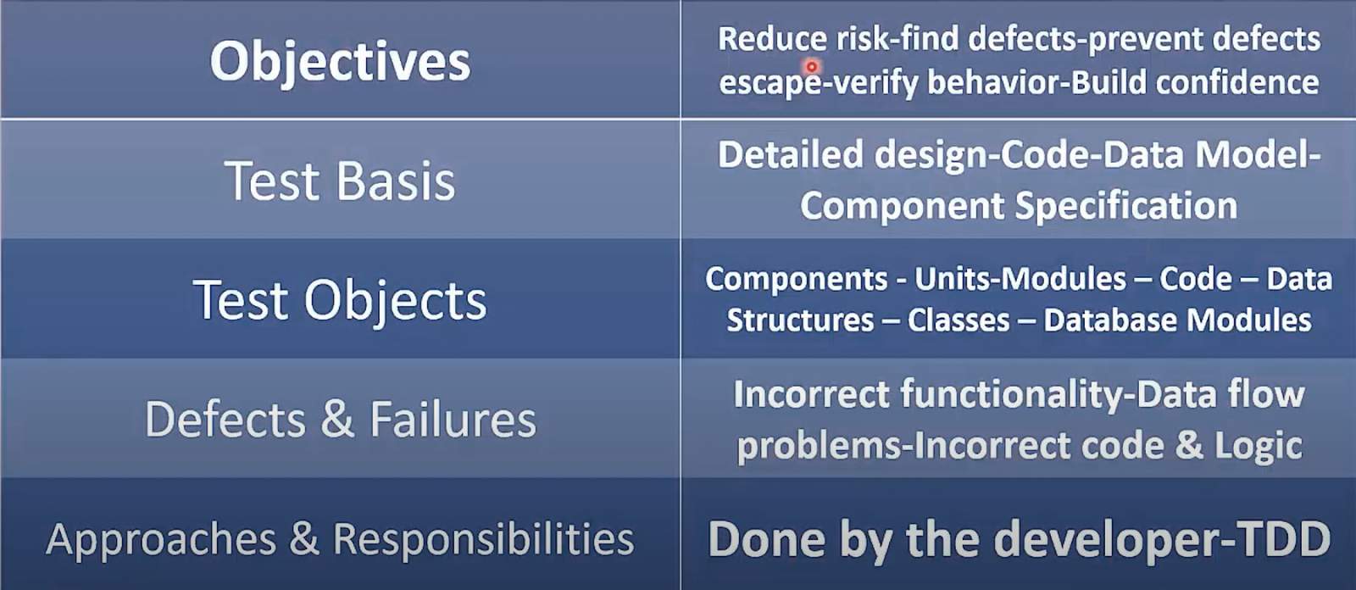
Unit Testing cont..

Slide 28
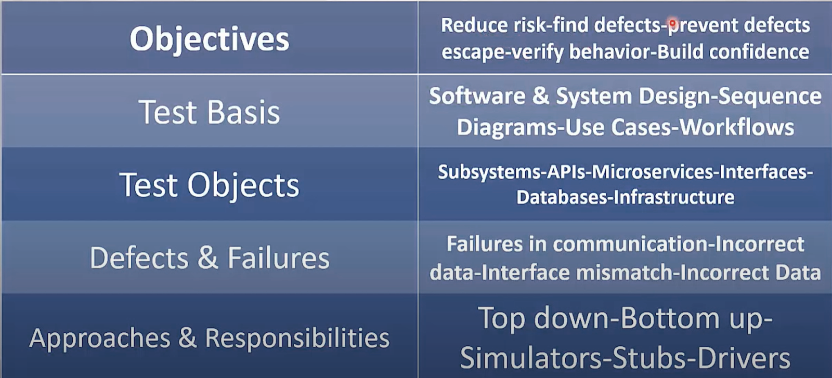
Integration Testing
Integration Testing is defined as a type of testing where software modules are integrated logically and tested as a group
Notes:
Microservices
بيعمل integration between components of system
test stubs are programs that simulate the behaviours of software components (or modules)
Api Gateaway

Slide 29
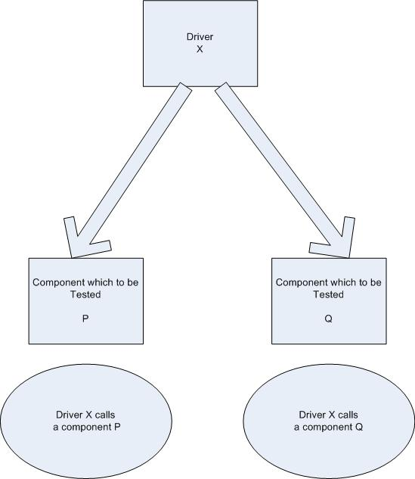
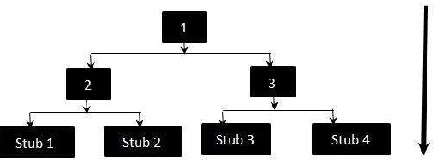
Bottom-Up Approach Using Drivers
Top-Down Approach Using Stubs

Slide 30
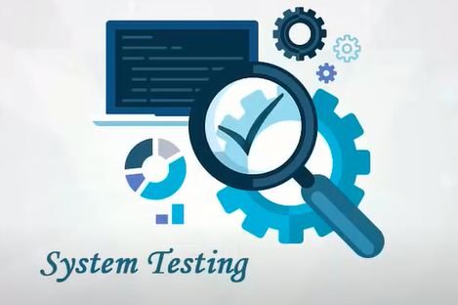
System testing
System testing focuses on the behavior and capabilities of a whole system or product

Slide 31
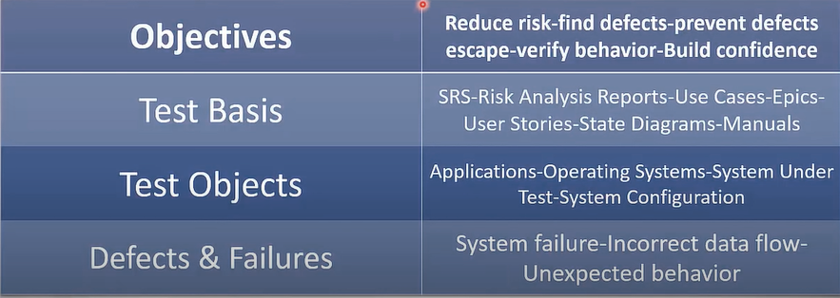
System testing cont..

Slide 32
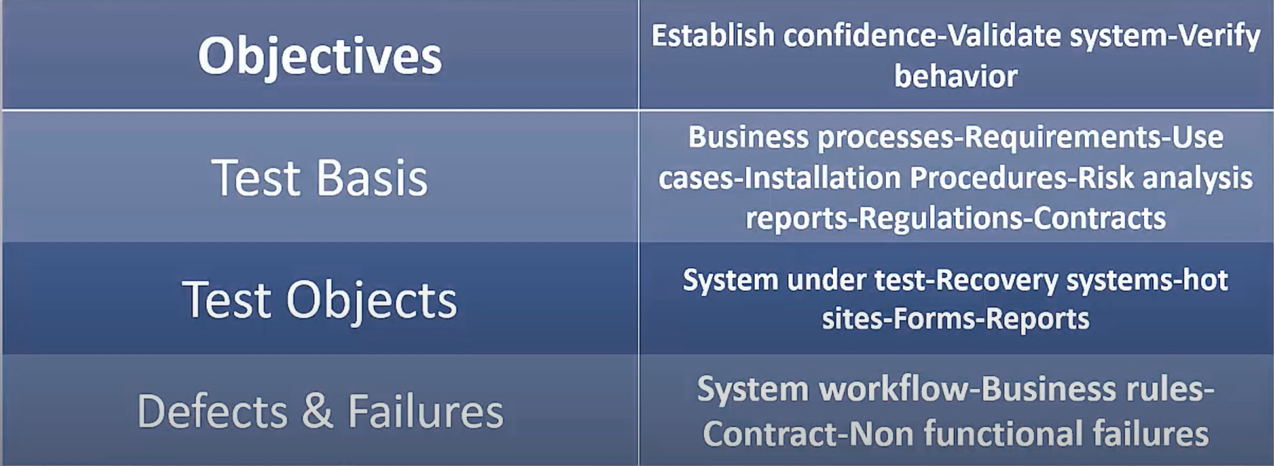
Acceptance Testing
Acceptance testing, like system testing

Slide 33


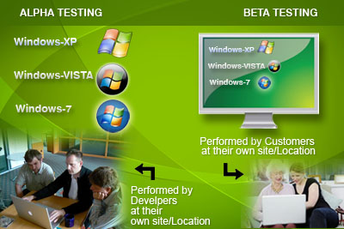
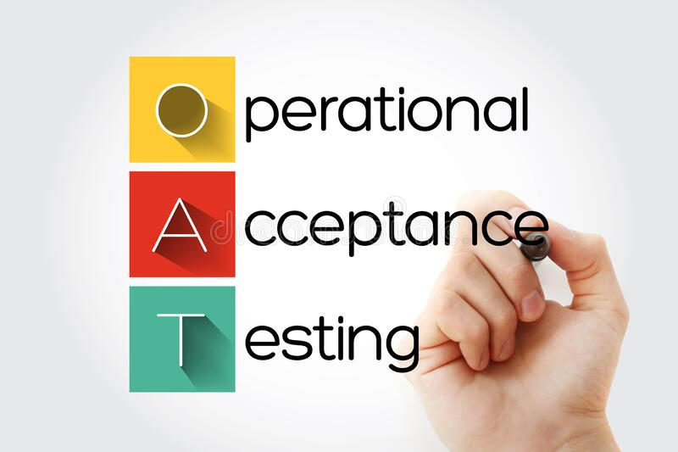
Acceptance Testing cont..
Common forms of acceptance testing include the following:
Notes:
User acceptance => validation
User acceptance testing
Operational acceptance testing
Contractual and regulatory acceptance testing
Alpha and beta testing. ➔ commercial off the shelf [window - office]
Alpha [testing Is done in Organization]
Beta [testing Is done in tester’s org] real user test sw
end users usually perform beta testing procedures.

Slide 34
Test Types

Slide 35
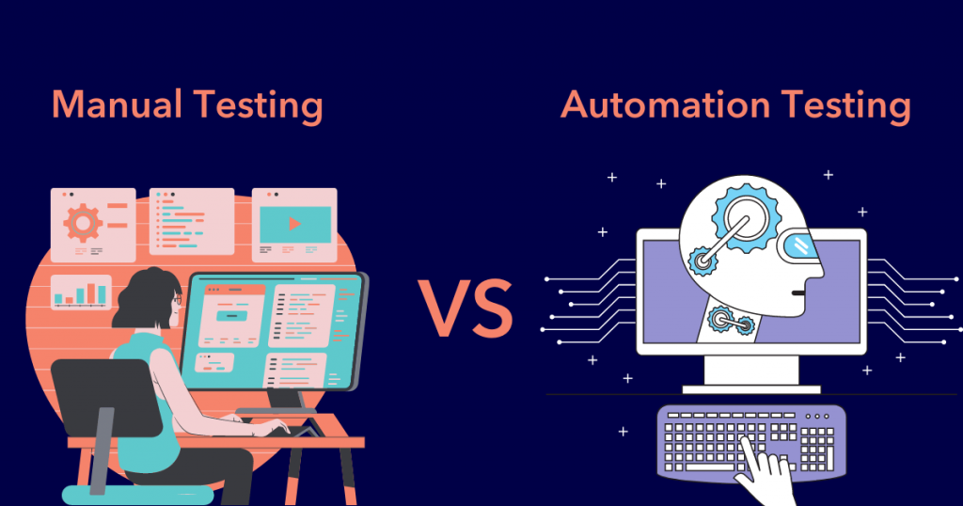
Manual & Automation Testing
Notes:
Manual testing
is a process of finding defects in the software manually.
testers will simulate end users to verify that all the features are working properly before software is released.
Automated testing
is a method using an automation tool testing tool to
write and execute test case suite on the software application,
comparing the actual results to the expected behavior and creating test reports.
Automation testing saves time, money, and effort.
when you want to run the same test cases across multiple machines at the same time. Automation testing is also a good way to avoid human error in your testing.

Slide 36
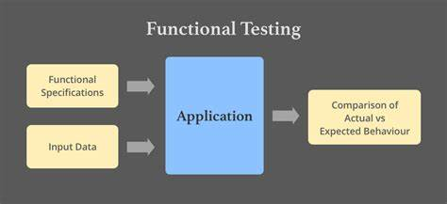
Function Testing
The functions are “what” the system should do
Notes:
evaluate functions that the system should perform.
Functional requirements may be described in work products such as
business requirements specifications,
epics, user stories,
use cases,
functional specifications,
Functional tests should be performed at all test levels (e.g., tests for components may be based on a component specification), though the focus is different at each level
Functional testing considers the behavior of the software, so black-box techniques may be used to derive test conditions and test cases for the functionality of the component or system

Slide 37
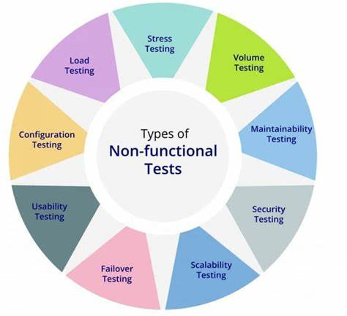
Non-Function Testing
Non-functional testing is the testing of “how well” the system behaves.

Slide 38
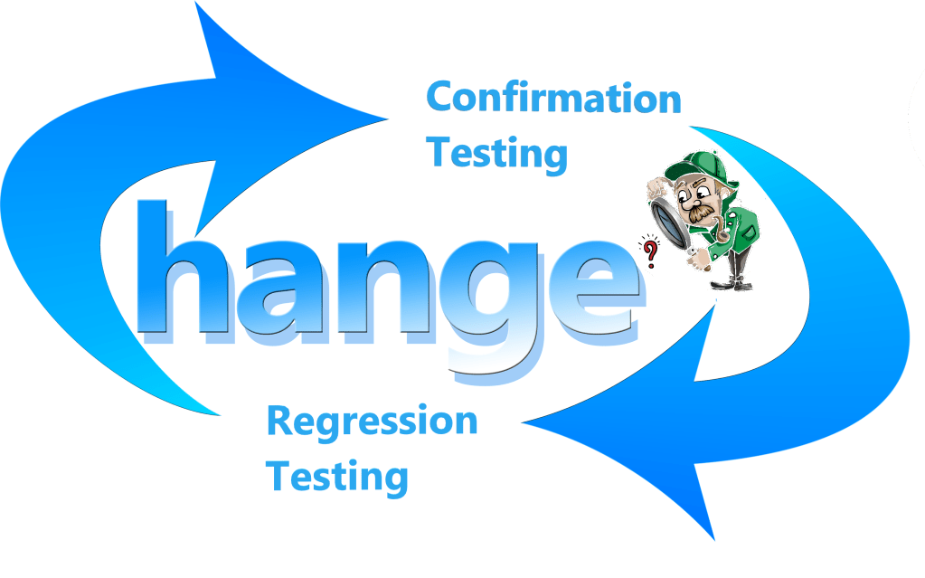
Change-Related Testing
When changes are made to a system, either to correct a defect or because of new or changing functionality,
testing should be done to confirm that the changes have corrected the defect or implemented the functionality correctly.

Slide 39

Confirmation Testing
The purpose of a confirmation test is to confirm whether the original defect has been successfully fixed.

Slide 40

Regression Testing
Regression testing involves running tests to detect such unintended side-effects.
Notes:
Regression testing: It is possible that a change made in one part of the code, whether a fix or another type of change, may accidentally affect the behavior of other parts of the code, whether within the same component, in other components of the same system

Slide 41
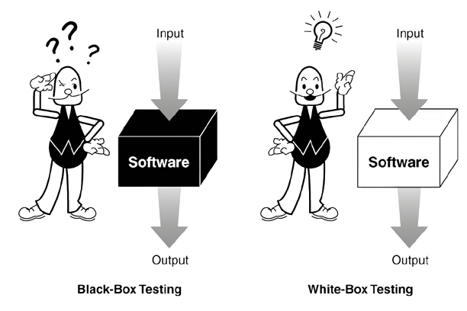
Black Box VS White Box
Notes:
Black Box Testing [specification based] is a software testing method in which the internal structure/design/implementation of the item being tested is not known to the tester. Only the external design and structure are tested.
It is mostly done by software testers.
Using in acceptance testing and system testing levels
Black-box test design techniques-
Decision table testing[rules and conditions]
State transition
Use case technique
Boundary value analysis
All-pairs testing
Equivalence partitioning
Error guessing
White Box Testing[glass box or structured based] is a software testing method in which the internal structure/design/implementation of the item being tested is known to the tester. Implementation and impact of the code are tested.
It is mostly done by software developers.
Using in integration and unit testing levels
White-box test design techniques-
Decision testing
Statement testing
Control flow testing
Data flow testing
Branch testing

Slide 42
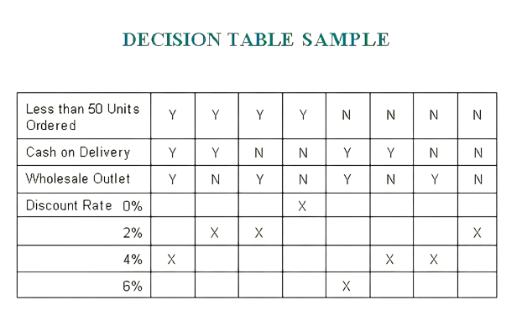
Black Box

Slide 43
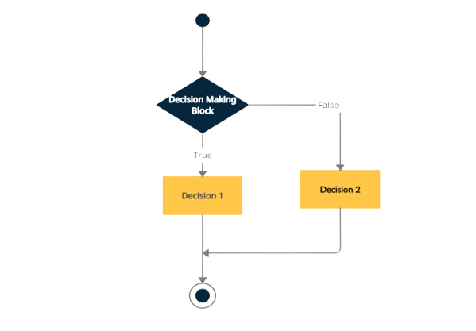
White Box
Decision coverage

Slide 44
Test strategies
Test Plan and Test Strategy Both have similar goals, to ensure that the software is working perfectly.
The test strategy comes first, followed by the test plan.
components of the test strategy:
Scope and Overview.
Testing Methodology.
Testing Environment Specifications.
Testing Tools.
Release Control.
Risk Analysis.
Review and Approvals.
Notes:
Test Plan
The test plan is a very detailed document that will determine the main points of the testing. It will have information within the document that includes the destinations, timescales, techniques, estimations, and assets required for the software testing.
Test Strategy
The test strategy is a set of instructions/protocols to explain and detail the test design and showcase how to perform the test. An arrangement describes the approach for testing and answers what is required to complete and how to achieve it.
1. Scope and Overview: Scope and Overview is the first section of the test strategy paper. Any product’s overview includes information about who should approve, review, and use the document. The testing activities and phases that must be approved were also described in the test strategy paper.
2. Testing Methodology: Testing methodology is the next module in the test strategy document, and it is used to specify the degrees of testing, testing procedures, roles, and duties of all team members. The change management process, which includes the modification request submission, pattern to be utilized, and activity to manage the request, is also included in the testing strategy.
3. Testing Environment Specifications: Testing Environment Specification is another section of the test strategy paper. The specification of the test data requirements, as we well know, is quite important. As a result, the testing environment specification in the test strategy document includes clear instructions on how to produce test data. This module contains information on the number of environments and the required setup.
4. Testing Tools: Testing tools are an important part of the test strategy document since it contains all of the information on the test management and automation tools that are required for test execution. The necessary approaches and tools for security, performance, and load testing are dictated by the details of the open-source or commercial tool and the number of users it can support.
5. Release Control: Release Control is a crucial component of the test strategy document. It’s used to make sure that test execution and release management strategies are established in a systematic way.
6. Risk Analysis: Risk Analysis is the next section of the test strategy paper. All potential hazards associated with the project are described in the test strategy document and can become an issue during test execution.
7. Review and Approval: Review and Approval is the last section of the Testing strategy paper.
When all of the testing activities are stated in the test strategy document, it is evaluated by the persons that are involved, such as:
System Administration Team.
Project Management Team.
Development Team.
Business Team.

Slide 45
Types of Test Strategies
Analytical strategy
Model-based strategy
Methodical strategy
Standards or process compliant strategy
Reactive strategy
Consultative strategy
Regression averse strategy
Test Strategy Selection
nature and size of the organization.
the project needs, for example, safety and security applications necessitate a more rigorous technique.
Is this a short-term or long-term strategy?
Project requirements.
Notes:
Analytical strategy: For instance, risk-based testing and requirements-based testing are two types of testing. After examining the test premise, such as risks or requirements, the testing team sets the testing circumstances to be covered. In the instance of requirements-based testing, the requirements are examined to determine the test circumstances. Then tests are created, implemented, and run to ensure that the requirements are met. Even the findings are kept track of in terms of requirements, such as those who were tested and passed, those that were tested but failed, those that were not fully tested, and so on.
Model-based strategy: The testing team selects an actual or anticipated circumstance and constructs a model for it, taking into account inputs, outputs, processes, and possible behavior. Models are also created based on existing software, technology, data speeds, infrastructure, and other factors. Let’s look at a case where you’re testing a mobile app. Models to simulate outgoing and receiving traffic on a mobile network, the number of active/inactive users, predicted growth, and other factors may be constructed to conduct performance testing.
Methodical strategy: In this case, test teams adhere to a quality standard (such as ISO25000), checklists, or just a set of test circumstances. Specific types of testing (such as security) and application domains may have standard checklists. For example, while performing maintenance testing, a checklist describing relevant functions, their properties, and so on is sufficient.
Standards or process compliant strategy: This method is well-exemplified by medical systems that adhere to US Food and Drug Administration (FDA) guidelines. The testers follow the methods or recommendations established by the standards committee or a panel of enterprise specialists to determine test conditions, identify test cases, and assemble the testing team. In the case of an Agile program, testers will create a complete test strategy for each user story, starting with establishing test criteria, developing test cases, conducting tests, reporting status, and so on.
Reactive strategy: Only when the real program is released are tests devised and implemented. As a result, testing is based on faults discovered in the real system. Consider the following scenario: you’re conducting exploratory testing. Test charters are created based on the features and functionalities that already exist. The outcomes of the testing by testers are used to update these test charters. Agile development initiatives can also benefit from exploratory testing.
Consultative strategy: In the same way, that user-directed testing uses input from key stakeholders to set the scope of test conditions, this testing technique does as well. Let’s consider a scenario in which the browser compatibility of any web-based application is being evaluated. In this section, the app’s owner would provide a list of browsers and their versions in order of preference. They may also include a list of connection types, operating systems, anti-malware software, and other requirements for the program to be tested against. Depending on the priority of the items in the provided lists, the testers can use various strategies such as pairwise or equivalence splitting.
Regression averse strategy: In this case, the testing procedures are aimed at lowering the risk of regression for both functional and non-functional product aspects. Using the web application as an example, if the program needs to be tested for regression issues, the testing team can design test automation for both common and unusual use cases. They can also employ GUI-based automation tools to conduct tests every time the application is updated. Any of the strategies outlined above does not have to be used for any testing job. Two or more strategies may be integrated depending on the needs of the product and the organization.

Slide 46
Test Tools

Slide 47
Test Tools
Test Tools
Directly used in testing
Management Tools

Slide 48
Test Tools Purposes
Improve the efficiency of test activities by automating repetitive tasks or tasks that require significant resources when done manually.
Improve the efficiency of test activities by supporting manual test activities throughout the test process.
Improve the quality of test activities by allowing for more consistent testing and a higher level of defect reproducibility.
Automate activities that cannot be executed manually.
Increase reliability of testing.

Slide 49

Intrusive Tools
Intrusive tools may affect the actual outcome of the test.
The consequence of using intrusive tools is called the probe effect.

Slide 50
Tools Support For Management Of Testing
ALM Tools
Continuous Integration Tools (D)
Defect Management Tools
Requirements Management Tools

Slide 51
Tools Support For Test Design & Implementation
Test Design Tools
Test-Data Preparation Tools
Test Driven Tools(D)
Behavior-
driven Tools(BDD)
Acceptance Test Driven Tools(ATDD)

Slide 52
Tools Support For Test Execution & Logging
Test Execution Tools
Coverage Tools (T/D)

Slide 53
Tools Support For Performance Measurement
Monitoring Tools
Dynamic Analysis Tools(D)
Performance Testing Tools

Slide 54
Tools Support For Specialized Testing Needs
Localization Testing
Data Quality Assessment
Security Testing
Accessibility Testing
Usability Testing
Data conversion & Migration

Slide 55
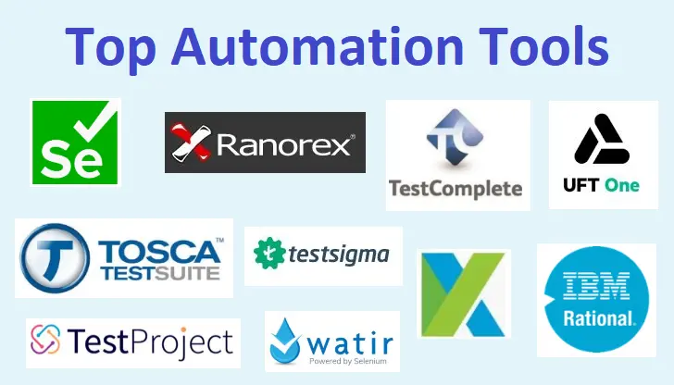
Benefits Of Test Execution Tools (Automation)
Reduction in repetitive manual work , thus saving time.
Greater consistency and repeatability.
More objective assessment .
Easier access to information.

Slide 56
Risks Of Test Execution Tools (Automation)
Unrealistic expectation of tools.
Underestimating time , cost & effort for the initial introduction of tool and also to achieve significant benefit from it.
The effort required to maintain the test assets generated by the tool may be underestimated .
The tool may be relied on too much.
Relationships and interoperability issues between critical tools may be neglected .
Vendor problem (retire or sell the tool/poor response /go out of business .
An open source project may be suspended.
A new platform or technology may not be supported by tool.

Slide 57
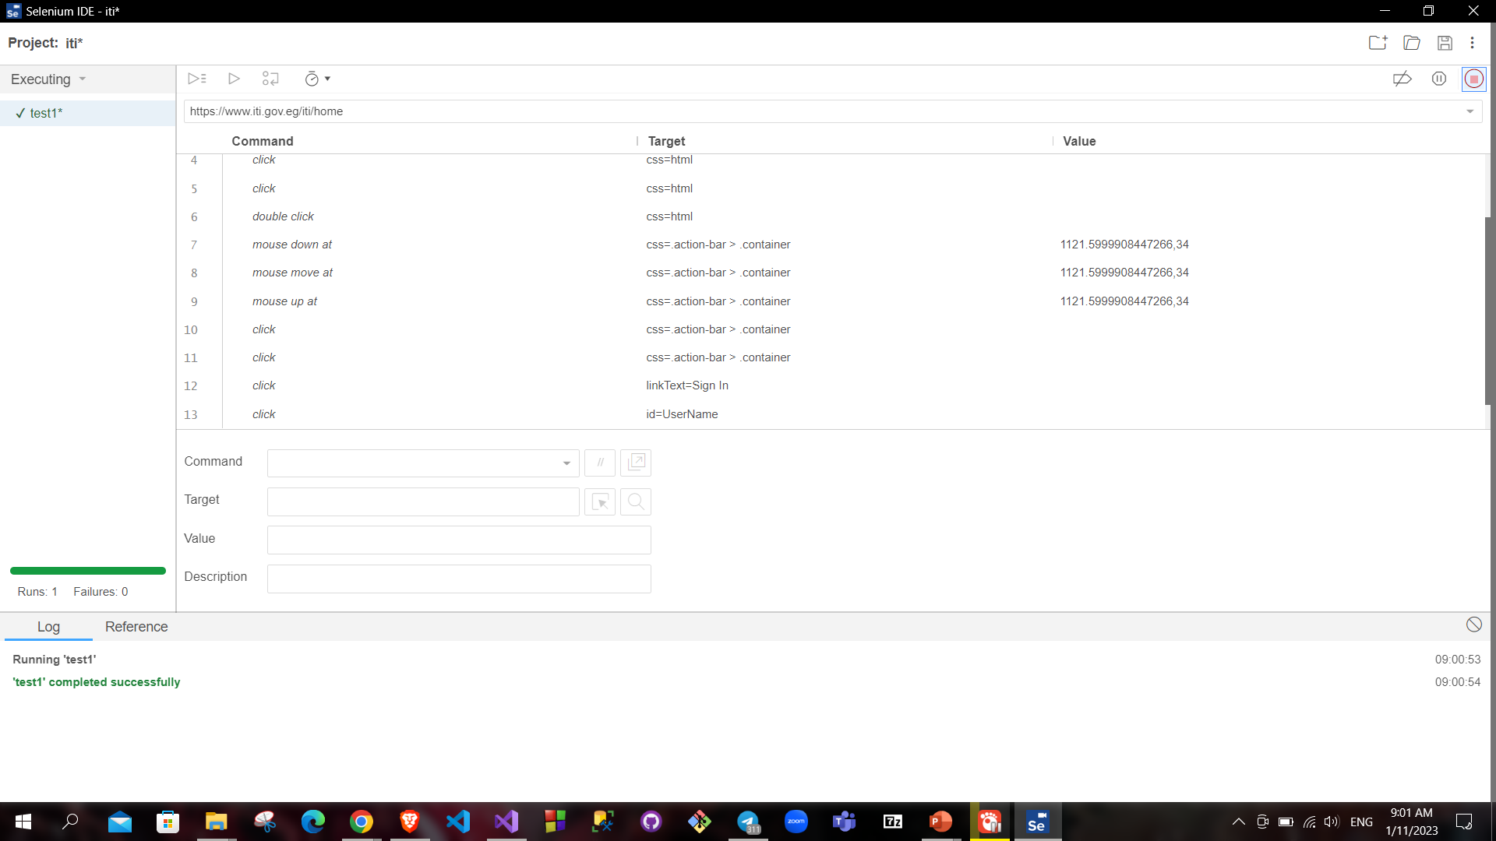
Demo Selenium

Slide 58
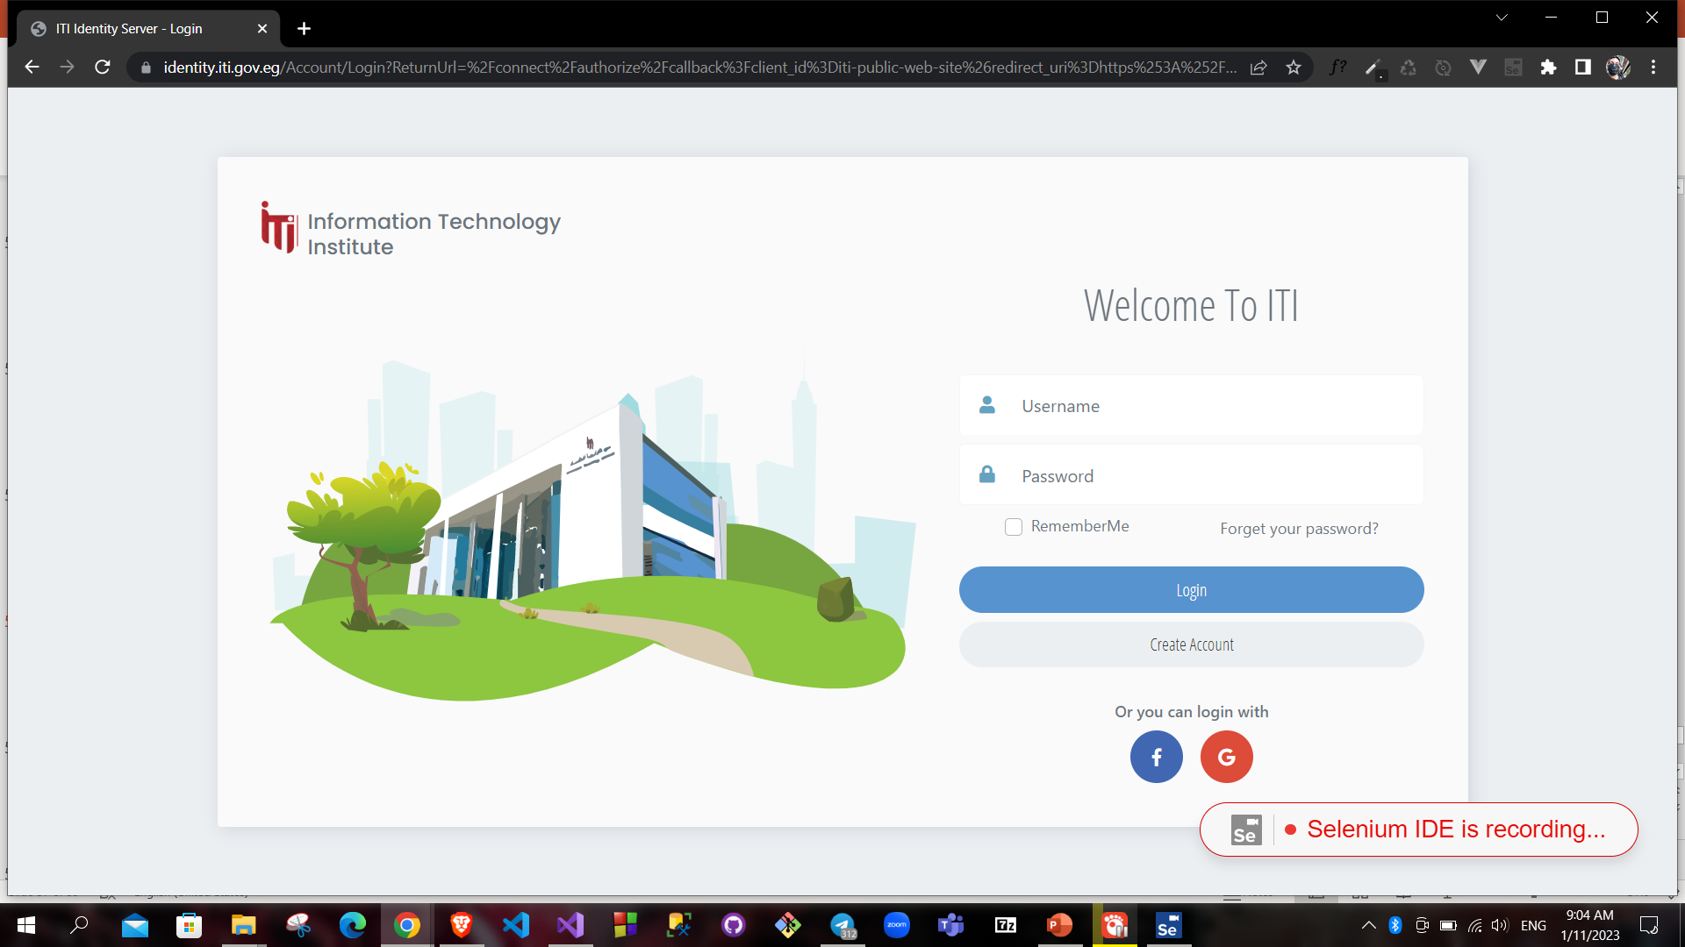
Demo Selenium

Slide 59
References
TDD introduction with Ameer Gaafar https://www.youtube.com/playlist?list=PLZPHP6RGS50NtpHLee-eInDbFqy3P303g
Testing Levels & Types
https://www.youtube.com/watch?v=HA-da0bgGzg&list=PLbJF4g421wqnHTxbGDgm-vqgl3wfj5mMg
Unit Testing | Software Testing – GeeksforGeeks
https://www.softwaretestinghelp.com/what-is-component-testing-or-module-testing/
https://www.programsbuzz.com/article/change-related-testing
https://www.guru99.com/software-testing-introduction-importance.html
https://geekflare.com/difference-bug-defect-error-failure-fault-testing/
https://salsa.digital/insights/a-brief-history-of-software-testing
https://www.geeksforgeeks.org/benefits-of-software-testing/

Slide 60
Thank You

